Slide 1
13
The Peripheral Nervous System and Reflex Activity: Part D

Slide 2
Peripheral Motor Endings
PNS elements that activate effectors by releasing neurotransmitters

Slide 3
Review of Innervation of Skeletal Muscle
Takes place at neuromuscular junction
Neurotransmitter acetylcholine (ACh) released when nerve impulse reaches axon terminal
ACh binds to receptors, resulting in:
  Movement of Na⁺ and K⁺ across membrane
  Depolarization of muscle cell
  An end plate potential, which triggers an action potential → muscle contraction

Slide 4
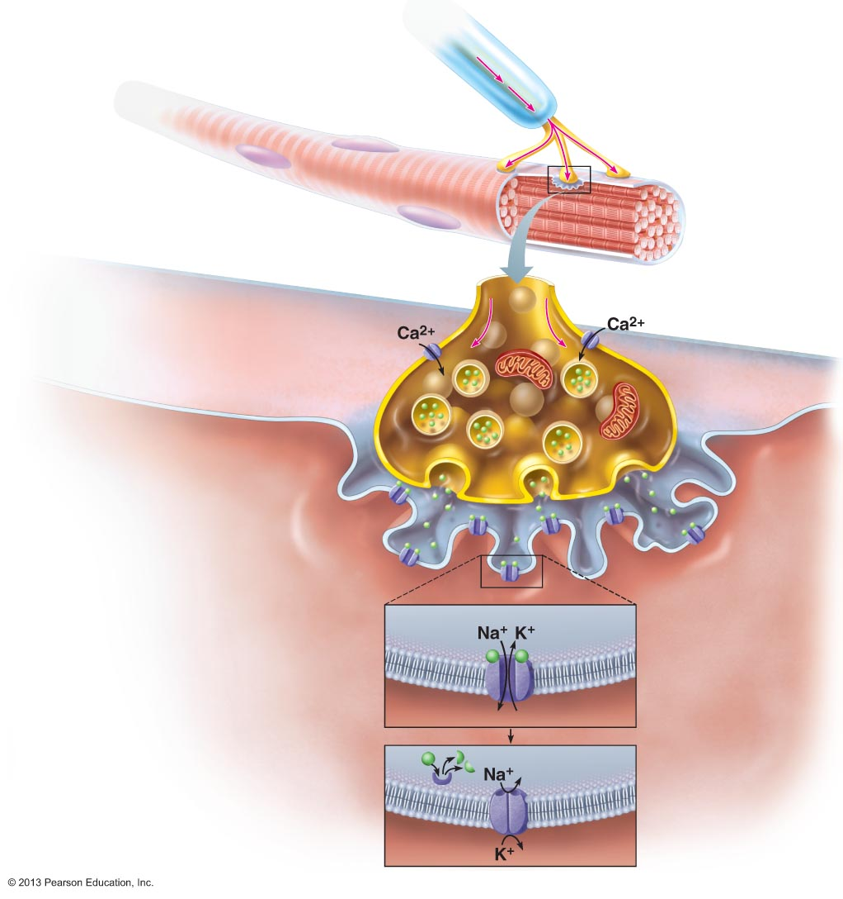
Figure 9.8 When a nerve impulse reaches a neuromuscular junction, acetylcholine (ACh) is released.
Slide 1
Myelinated axon
of motor neuron
Action
potential (AP)
Axon terminal of
neuromuscular
junction
Sarcolemma of
the muscle fiber
Action potential arrives at axon
terminal of motor neuron.
1
Voltage-gated Ca²⁺ channels open. Ca²⁺ enters the axon terminal moving down its electochemical gradient.
Synaptic vesicle
containing ACh
2
Axon terminal
of motor neuron
Synaptic
cleft
Fusing synaptic
vesicles
Ca²⁺ entry causes ACh (a
neurotransmitter) to be released
by exocytosis.
3
ACh
Junctional
folds of
sarcolemma
ACh diffuses across the synaptic cleft and binds to its receptors on
the sarcolemma.
4
Sarcoplasm of
muscle fiber
ACh binding opens ion
channels in the receptors that
allow simultaneous passage of
Na⁺ into the muscle fiber and K⁺
out of the muscle fiber. More Na⁺
ions enter than K⁺ ions exit,
which produces a local change
in the membrane potential called
the end plate potential.
5
Postsynaptic
membrane
ion channel opens;
ions pass.
ACh
Degraded ACh
Ion channel closes;
ions cannot pass.
ACh effects are terminated by
its breakdown in the synaptic
cleft by acetylcholinesterase and
diffusion away from the junction.
6
Acetylcho-
linesterase

Slide 5
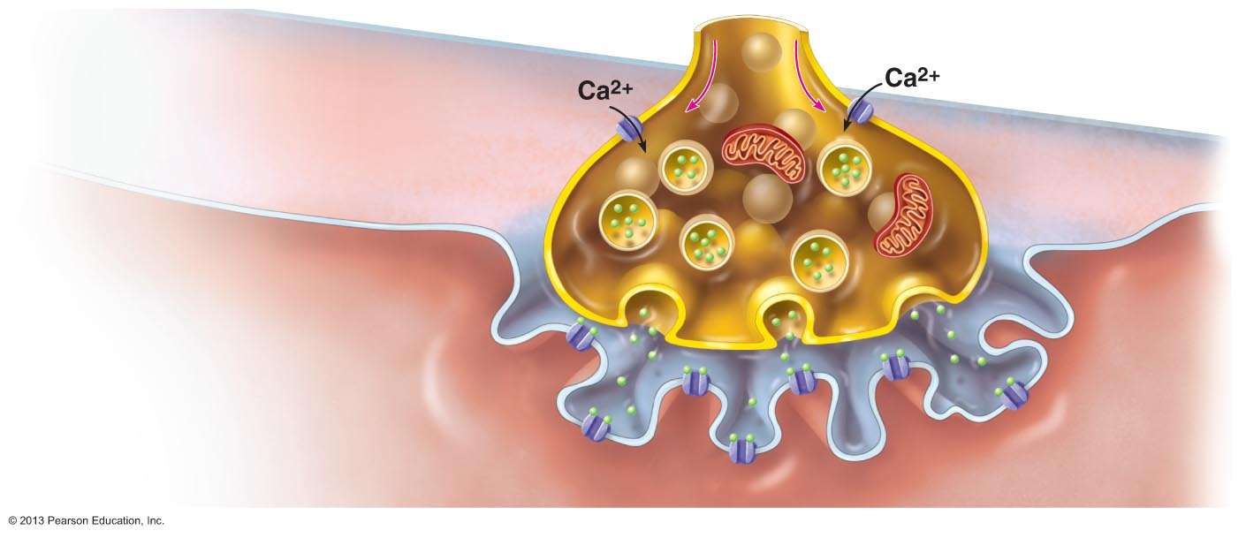
Figure 9.8 When a nerve impulse reaches a neuromuscular junction, acetylcholine (ACh) is released.
Slide 2
Action potential arrives at axon terminal of motor neuron.
1
Synaptic vesicle
containing ACh
Axon terminal
of motor neuron
Synaptic cleft
Fusing synaptic
vesiclesa
ACh
Junctional
folds of
sarcolemma
Sarcoplasm of
muscle fiber

Slide 6
Figure 9.8 When a nerve impulse reaches a neuromuscular junction, acetylcholine (ACh) is released.
Slide 3
Action potential arrives at axon terminal of motor neuron.
1
Voltage-gated Ca²⁺ channels open. Ca²⁺ enters the axon terminal moving down its electochemical gradient.
Synaptic vesicle
containing ACh
2
Axon terminal
of motor neuron
Synaptic cleft
Fusing synaptic
vesiclesa
ACh
Junctional
folds of
sarcolemma
Sarcoplasm of
muscle fiber

Slide 7
Figure 9.8 When a nerve impulse reaches a neuromuscular junction, acetylcholine (ACh) is released.
Slide 4
Action potential arrives at axon terminal of motor neuron.
1
Voltage-gated Ca²⁺ channels open. Ca²⁺ enters the axon terminal moving down its electochemical gradient.
Synaptic vesicle
containing ACh
2
Axon terminal
of motor neuron
Synaptic cleft
Fusing synaptic
vesiclesa
Ca²⁺ entry causes ACh (a
neurotransmitter) to be released
by exocytosis.
3
ACh
Junctional
folds of
sarcolemma
Sarcoplasm of
muscle fiber

Slide 8
Figure 9.8 When a nerve impulse reaches a neuromuscular junction, acetylcholine (ACh) is released.
Slide 5
Action potential arrives at axon terminal of motor neuron.
1
Voltage-gated Ca²⁺ channels open. Ca²⁺ enters the axon terminal moving down its electochemical gradient.
Synaptic vesicle
containing ACh
2
Axon terminal
of motor neuron
Synaptic cleft
Fusing synaptic
vesiclesa
Ca²⁺ entry causes ACh (a
neurotransmitter) to be released
by exocytosis.
3
ACh
Junctional
folds of
sarcolemma
ACh diffuses across the synaptic cleft and binds to its receptors on
the sarcolemma.
4
Sarcoplasm of
muscle fiber

Slide 9
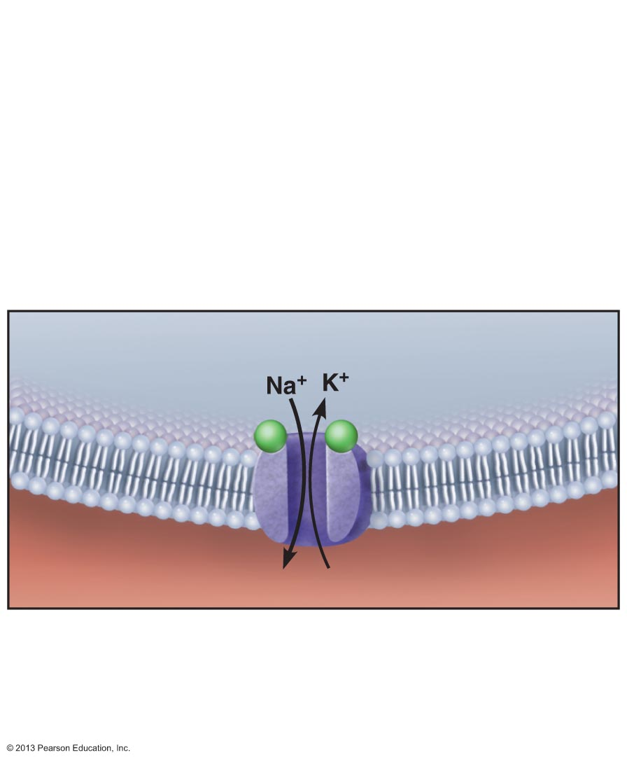
Figure 9.8 When a nerve impulse reaches a neuromuscular junction, acetylcholine (ACh) is released.
Slide 6
5
ACh binding opens ion
channels in the receptors that
allow simultaneous passage of
Na+ into the muscle fiber and K+
out of the muscle fiber. More Na+
ions enter than K+ ions exit,
which produces a local change
in the membrane potential called
the end plate potential.
Postsynaptic membrane
ion channel opens;
ions pass.

Slide 10
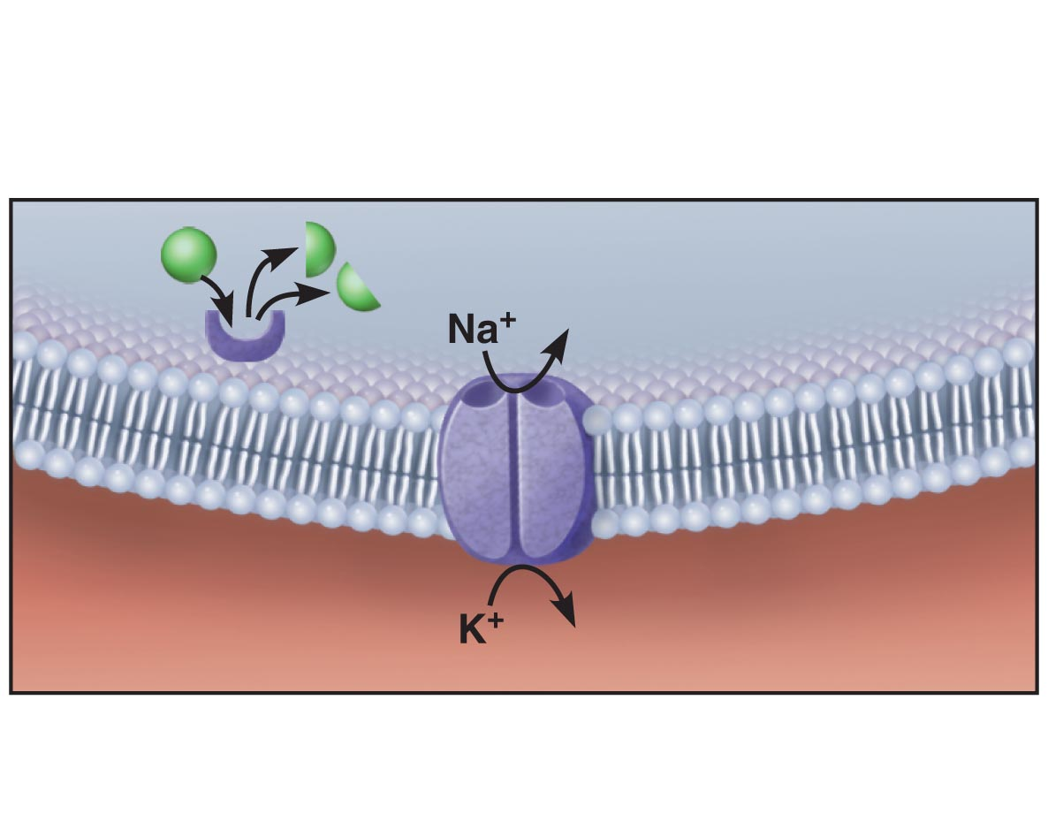
Figure 9.8 When a nerve impulse reaches a neuromuscular junction, acetylcholine (ACh) is released.
Slide 7
6
ACh effects are terminated by
its breakdown in the synaptic
cleft by acetylcholinesterase and
diffusion away from the junction.
ACh
Degraded ACh
Acetylcholinesterase
Ion channel closes;
ions cannot pass.

Slide 11
Figure 9.8 When a nerve impulse reaches a neuromuscular junction, acetylcholine (ACh) is released.
Slide 8
Myelinated axon
of motor neuron
Action
potential (AP)
Axon terminal of
neuromuscular
junction
Sarcolemma of
the muscle fiber
Action potential arrives at axon
terminal of motor neuron.
1
Voltage-gated Ca²⁺ channels open. Ca²⁺ enters the axon terminal moving down its electochemical gradient.
Synaptic vesicle
containing ACh
2
Axon terminal
of motor neuron
Synaptic
cleft
Fusing synaptic
vesicles
Ca²⁺ entry causes ACh (a
neurotransmitter) to be released
by exocytosis.
3
ACh
Junctional
folds of
sarcolemma
ACh diffuses across the synaptic cleft and binds to its receptors on
the sarcolemma.
4
Sarcoplasm of
muscle fiber
ACh binding opens ion
channels in the receptors that
allow simultaneous passage of
Na⁺ into the muscle fiber and K⁺
out of the muscle fiber. More Na⁺
ions enter than K⁺ ions exit,
which produces a local change
in the membrane potential called
the end plate potential.
5
Postsynaptic
membrane
ion channel opens;
ions pass.
ACh
Degraded ACh
Ion channel closes;
ions cannot pass.
ACh effects are terminated by
its breakdown in the synaptic
cleft by acetylcholinesterase and
diffusion away from the junction.
6
Acetylcho-
linesterase

Slide 12
Review of Innervation of Visceral Muscle and Glands
Autonomic motor endings and visceral effectors are simpler than somatic junctions
Branches form synapses en passant via varicosities
Acetylcholine and norepinephrine act indirectly via second messengers
Visceral motor responses slower than somatic responses

Slide 13
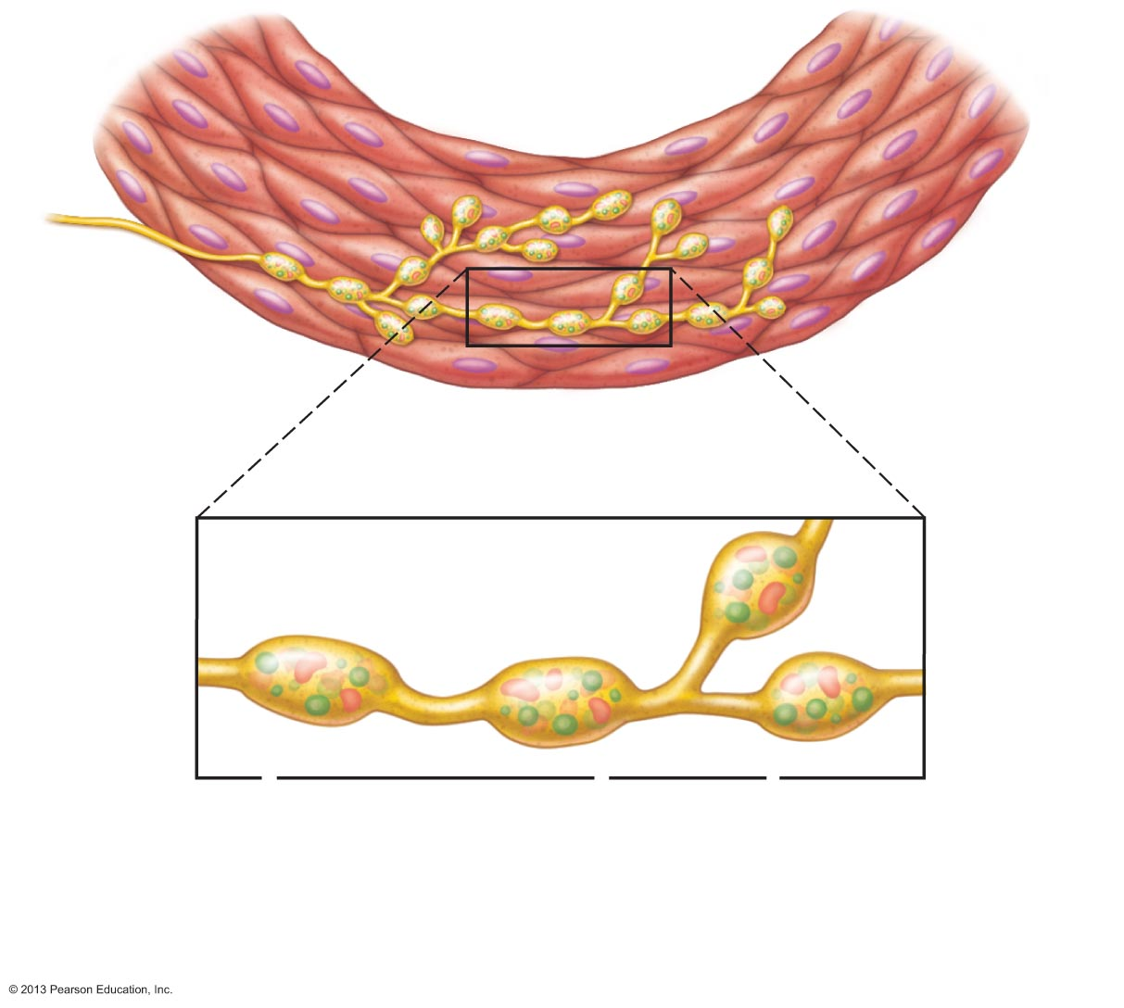
Figure 9.26 Innervation of smooth muscle.
Varicosities
Autonomic
nerve fibers
innervate
most smooth
muscle fibers.
Smooth
muscle
cell
Synaptic
vesicles
Mitochondrion
Varicosities release
their neurotransmitters
into a wide synaptic
cleft (a diffuse junction).

Slide 14
Levels of Motor Control
Cerebellum and basal nuclei are ultimate planners and coordinators of complex motor activities
Complex motor behavior depends on complex patterns of control
  Segmental level
  Projection level
  Precommand level

Slide 15
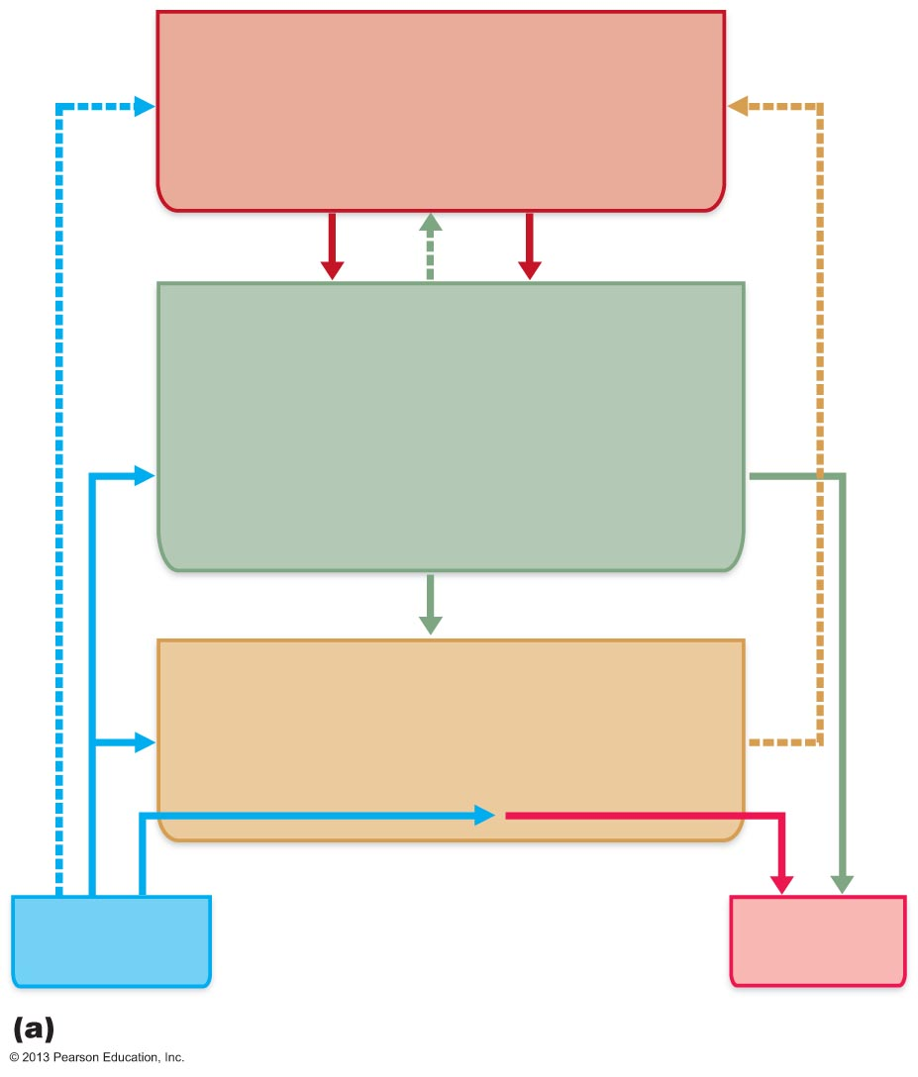
Figure 13.14a Hierarchy of motor control.
Precommand Level (highest)
• Cerebellum and basal nuclei
• Programs and instructions
(modified by feedback)
Projection Level (middle)
• Motor cortex (pyramidal pathways)
and brain stem nuclei (vestibular,
red, reticular formation, etc.)
• Conveys instructions to spinal cord
motor neurons and sends a copy of
that information to higher levels
Segmental Level (lowest)
• Spinal cord
• Contains central pattern generators
(CPGs)
Sensory
input
Reflex activity
Motor
output
Levels of motor control and their interactions

Slide 16
Segmental Level
Lowest level of motor hierarchy
  Reflexes and automatic movements
Central pattern generators (CPGs): segmental circuits that activate networks of ventral horn neurons to stimulate specific groups of muscles
Controls locomotion and specific, oft-repeated motor activity

Slide 17
Projection Level
Consists of
  Upper motor neurons that initiate direct (pyramidal) system to produce voluntary skeletal muscle movements
  Brain stem motor areas that oversee indirect (extrapyramidal) system to control reflex and CPG-controlled motor actions
Projection motor pathways send information to lower motor neurons, and keep higher command levels informed of what is happening

Slide 18
Precommand Level
Neurons in cerebellum and basal nuclei
  Regulate motor activity
  Precisely start or stop movements
  Coordinate movements with posture
  Block unwanted movements
  Monitor muscle tone
  Perform unconscious planning and discharge in advance of willed movements

Slide 19
Precommand Level
Cerebellum
  Acts on motor pathways through projection areas of brain stem
  Acts on motor cortex via thalamus to fine-tune motor activity
Basal nuclei
  Inhibit various motor centers under resting conditions

Slide 20
Figure 13.14a Hierarchy of motor control.
Precommand Level (highest)
• Cerebellum and basal nuclei
• Programs and instructions
(modified by feedback)
Projection Level (middle)
• Motor cortex (pyramidal pathways)
and brain stem nuclei (vestibular,
red, reticular formation, etc.)
• Conveys instructions to spinal cord
motor neurons and sends a copy of
that information to higher levels
Segmental Level (lowest)
• Spinal cord
• Contains central pattern generators
(CPGs)
Sensory
input
Reflex activity
Motor
output
Levels of motor control and their interactions

Slide 21
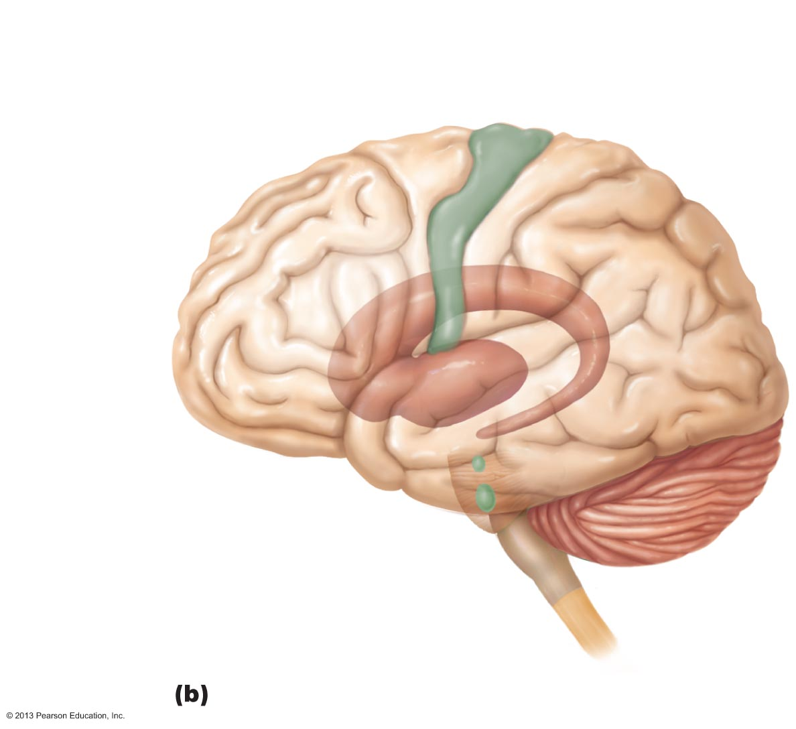
Figure 13.14b Hierarchy of motor control.
Precommand level
• Cerebellum
• Basal nuclei
Projection level
• Primary motor cortex
• Brain stem nuclei
Segmental level
• Spinal cord
Structures involved

Slide 22
Reflexes
Inborn (intrinsic) reflex - rapid, involuntary, predictable motor response to stimulus
  Example – maintain posture, control visceral activities
  Can be modified by learning and conscious effort
Learned (acquired) reflexes result from practice or repetition,
  Example – driving skills

Slide 23
Reflex Arc
Components of a reflex arc (neural path)
  1. Receptor—site of stimulus action
  2. Sensory neuron—transmits afferent impulses to CNS
  3. Integration center—either monosynaptic or polysynaptic region within CNS
  4. Motor neuron—conducts efferent impulses from integration center to effector organ
  5. Effector—muscle fiber or gland cell that responds to efferent impulses by contracting or secreting

Slide 24
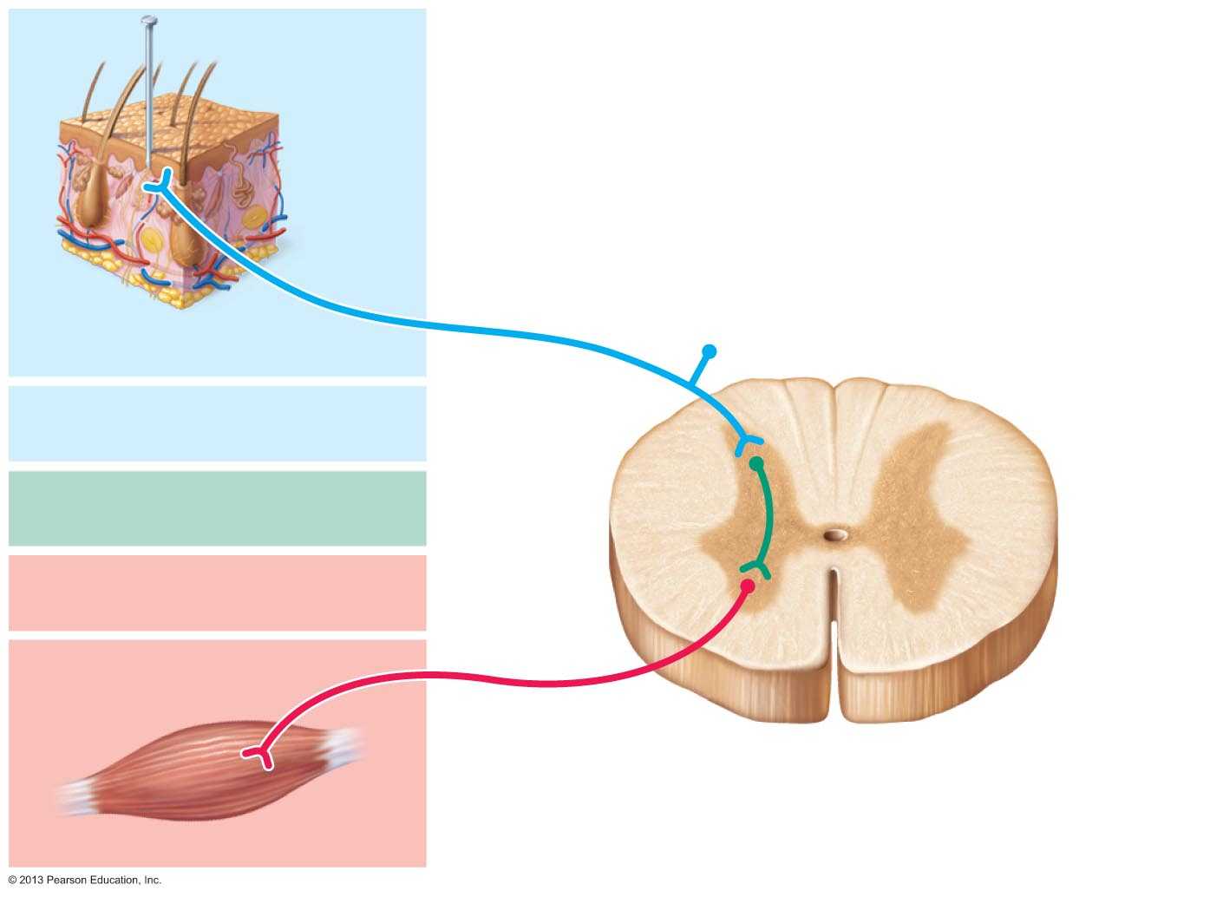
Figure 13.15 The five basic components of all reflex arcs.
Stimulus
Skin
1
Receptor
Interneuron
2
Sensory neuron
3
Integration center
4
Motor neuron
5
Effector
Spinal cord
(in cross scetion)

Slide 25
Reflexes
Functional classification
  Somatic reflexes
    Activate skeletal muscle
  Autonomic (visceral) reflexes
    Activate visceral effectors (smooth or cardiac muscle or glands)

Slide 26
Spinal Reflexes
Spinal somatic reflexes
  Integration center in spinal cord
  Effectors are skeletal muscle
Testing of somatic reflexes important clinically to assess condition of nervous system
  If exaggerated, distorted, or absent → degeneration/pathology of specific nervous system regions

Slide 27
Stretch and Tendon Reflexes
To smoothly coordinate skeletal muscle nervous system must receive proprioceptor input regarding
  Length of muscle
    From muscle spindles
  Amount of tension in muscle
    From tendon organs

Slide 28
Functional Anatomy of Muscle Spindles
Composed of 3–10 modified skeletal muscle fibers - intrafusal muscle fibers - wrapped in connective tissue capsule
  Effector fibers – extrafusal muscle fibers

Slide 29
Intrafusal Fibers
Noncontractile in central regions (lack myofilaments)
Two types of afferent endings
  Anulospiral endings (primary sensory endings)
    Endings wrap around spindle; stimulated by rate and degree of stretch
  Flower spray endings (secondary sensory endings)
    Small axons at spindle ends; respond to stretch

Slide 30
Muscle Spindles
Contractile end regions innervated by gamma (γ) efferent fibers - maintain spindle sensitivity
Note: extrafusal fibers (contractile muscle fibers) innervated by alpha (α) efferent fibers

Slide 31
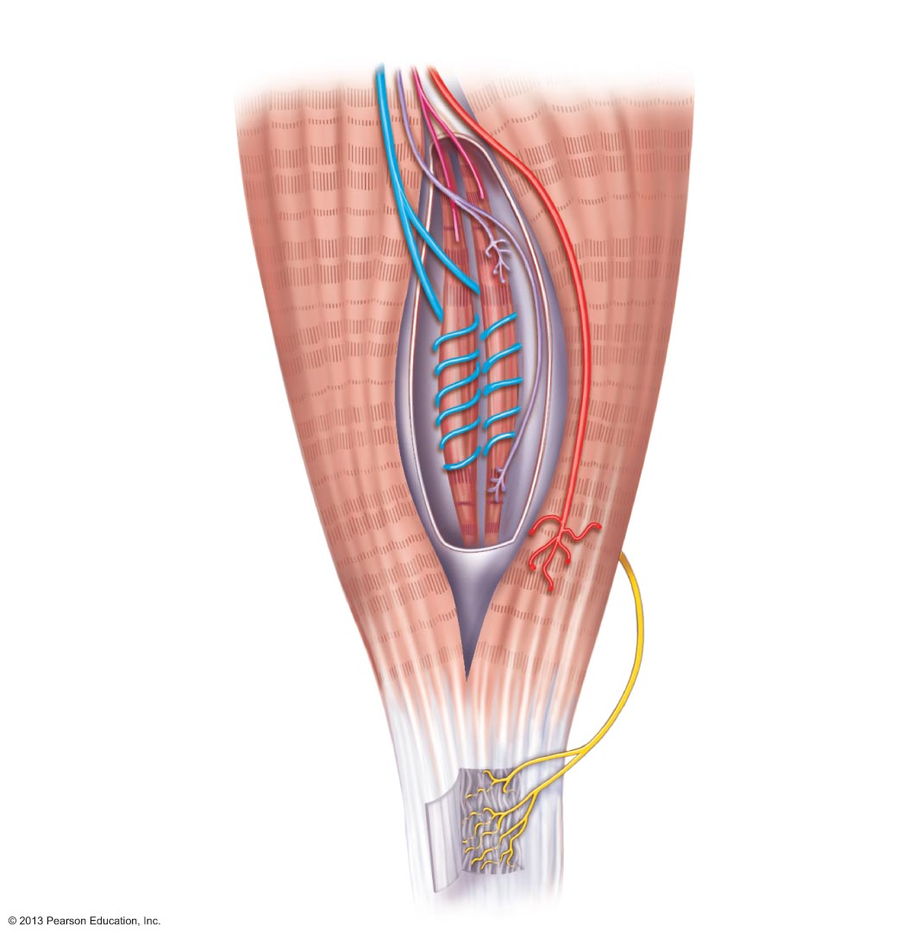
Figure 13.16 Anatomy of the muscle spindle and tendon organ.
Flower spray endings
(secondary sensory
endings)
γ Efferent (motor)
fiber to muscle spindle
Anulo-
spiral
endings
(primary
sensory
endings)
α Efferent
(motor) fiber
to extrafusal
muscle fibers
Extrafusal
muscle
fiber
Muscle
spindle
Intrafusal
muscle
fibers
Capsule
(connective
tissue)
Sensory
fiber
Tendon organ
Tendon

Slide 32
Muscle Spindles
Excited in two ways
  External stretch of muscle and muscle spindle
  Internal stretch of muscle spindle
    Activating γ motor neurons stimulates ends to contract, thereby stretching spindle
Stretch causes increased rate of impulses to spinal cord

Slide 33
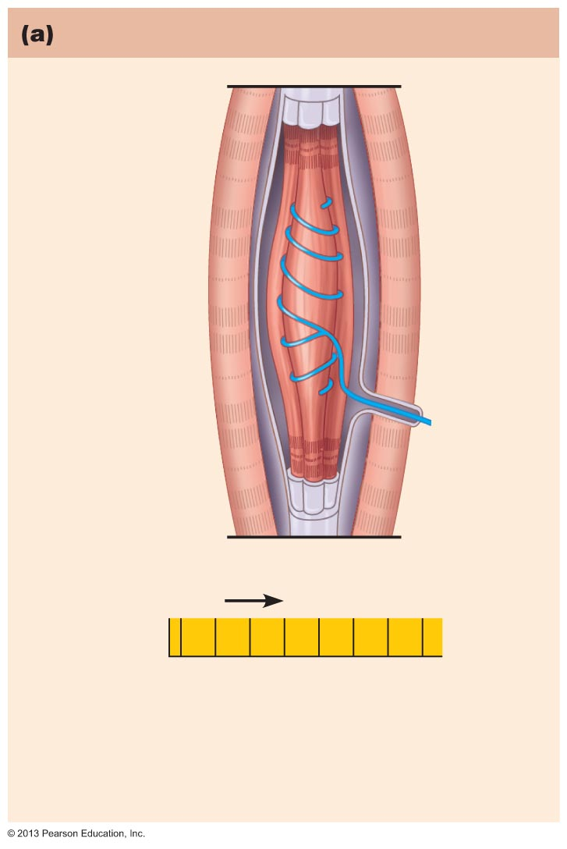
Figure 13.17a Operation of the muscle spindle. (1 of 2)
How muscle stretch is detected
Muscle
spindle
Intrafusal
muscle fiber
Sensory
fiber
Extrafusal
muscle fiber
Time
Unstretched muscle.
Action potentials (APs)
are generated at a
constant rate in the
associated sensory fiber.

Slide 34
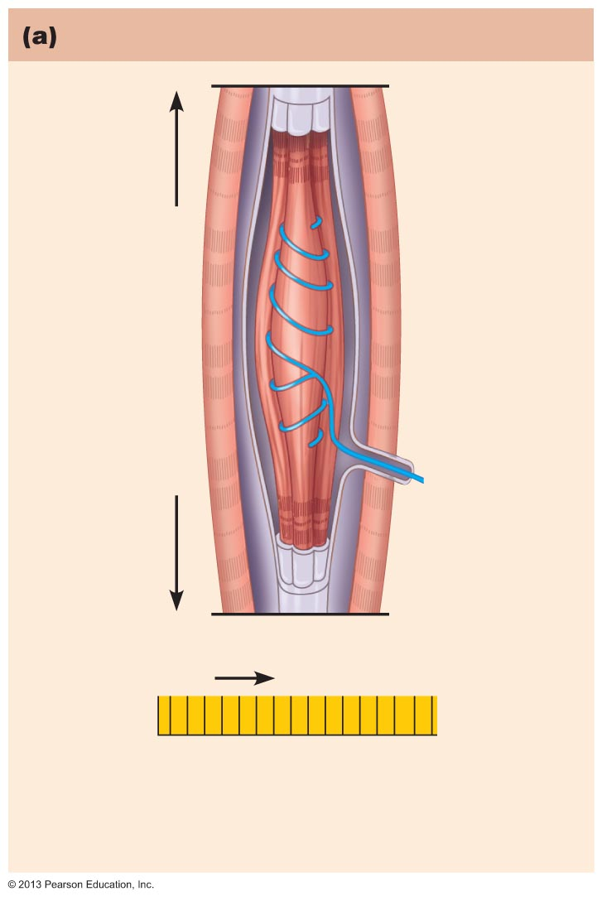
Figure 13.17a Operation of the muscle spindle. (2 of 2)
How muscle stretch is detected
Time
Stretched muscle.
Stretching activates the
muscle spindle, increasing
the rate of APs.

Slide 35
Muscle Spindles
Contracting muscle reduces tension on muscle spindle
Sensitivity lost unless muscle spindle shortened by impulses in γ motor neurons
α–γ coactivation maintains tension and sensitivity of spindle during muscle contraction

Slide 36
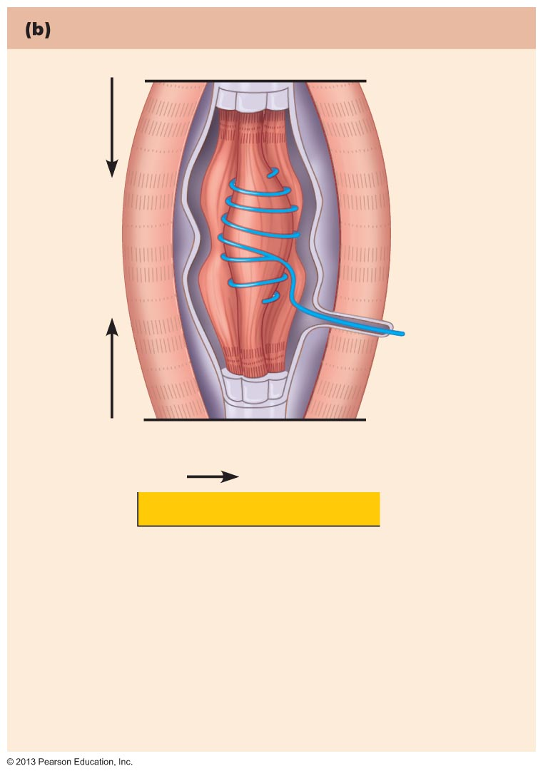
Figure 13.17b Operation of the muscle spindle. (1 of 2)
The purpose of α-γ coactivation
Time
If only α motor neurons
were activated. Only the
extrafusal muscle fibers
contract. The muscle
spindle becomes slack
and no APs are fired. It is
unable to signal further
length changes.

Slide 37
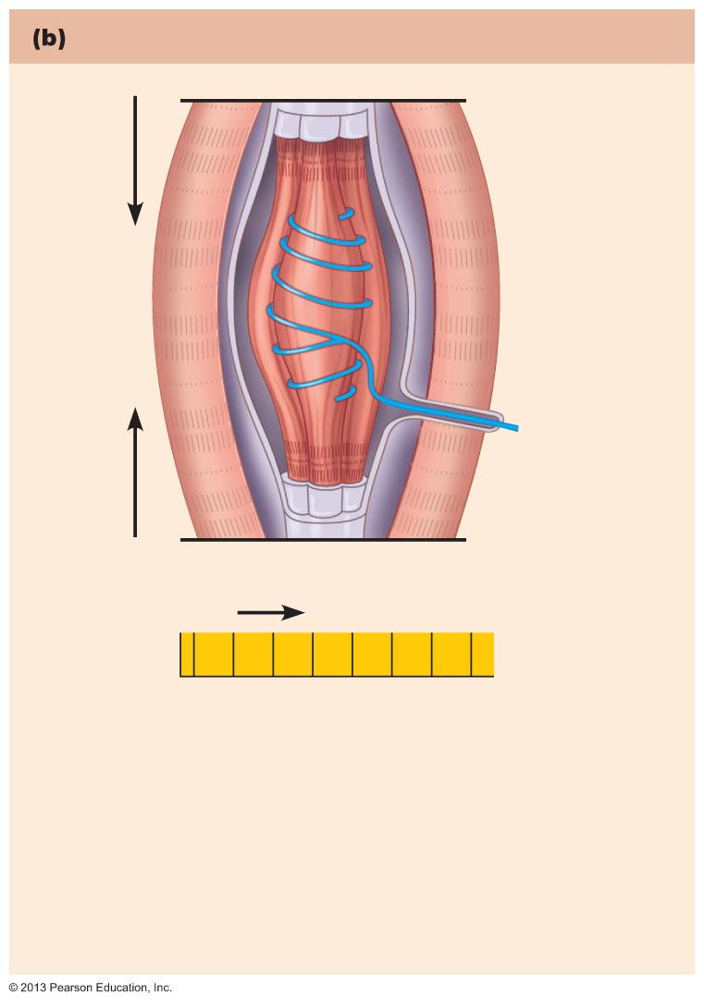
Figure 13.17b Operation of the muscle spindle. (2 of 2)
The purpose of α−γ coactivation
Time
But normally α-γ
coactivation occurs. Both
extrafusal and intrafusal
muscle fibers contract.
Tension is maintained in
the muscle spindle and it
can still signal changes in
length.

Slide 38
The Stretch Reflex
Maintains muscle tone in large postural muscles, and adjusts it reflexively
  Causes muscle contraction in response to increased muscle length (stretch)

Slide 39
Stretch Reflexes
How stretch reflex works
  Stretch activates muscle spindle
  Sensory neurons synapse directly with α motor neurons in spinal cord
  α motor neurons cause stretched muscle to contract
All stretch reflexes are monosynaptic and ipsilateral

Slide 40
Stretch Reflexes
Reciprocal inhibition also occurs—IIa fibers synapse with interneurons that inhibit α motor neurons of antagonistic muscles
  Example: In patellar reflex, stretched muscle (quadriceps) contracts and antagonists (hamstrings) relax

Slide 41
Stretch Reflexes
Positive reflex reactions indicate
  Sensory and motor connections between muscle and spinal cord intact
  Strength of response indicates degree of spinal cord excitability
Hypoactive or absent if peripheral nerve damage or ventral horn injury
Hyperactive if lesions of corticospinal tract

Slide 42
Adjusting Muscle Spindle Sensitivity
If γ neurons stimulated by brain → spindle stretched → contraction force maintained or increased
If γ neurons inhibited → spindle nonresponsive → muscle relaxes
Important as speed and difficulty increase
  E.g., gymnast on balance beam

Slide 43
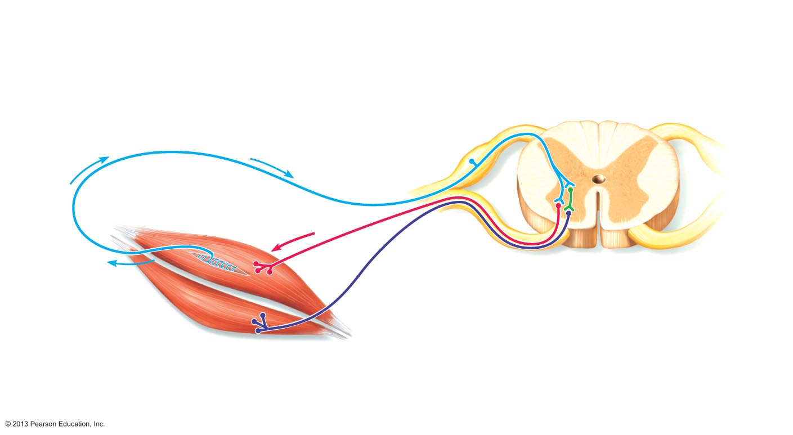
Figure 13.18 Stretch Reflex (1 of 2)
Slide 1
The events by which muscle stretch is
damped
The sensory neurons synapse directly with alpha motor neurons (red), which excite extrafusal fibers of the stretched muscle. Sensory fibers also synapse with interneurons (green) that inhibit motor neurons (purple) controlling antagonistic muscles.
2
1
When stretch activates muscle spindles, the associated sensory neurons (blue) transmit afferent impulses at higher frequency to the spinal cord.
Sensory
neuron
Cell body of
sensory neuron
+
Initial stimulus
(muscle stretch)
+
–
Spinal cord
Muscle spindle
Antagonist muscle
3b
3a
Efferent impulses of alpha motor neurons to antagonist muscles are reduced (reciprocal inhibition).
Efferent impulses of alpha motor neurons cause the stretched muscle to contract, whichresists or reverses the stretch.

Slide 44
Figure 13.18 Stretch Reflex (1 of 2)
Slide 2
The events by which muscle stretch is
damped
1
When stretch activates muscle spindles, the associated sensory neurons (blue) transmit afferent impulses at higher frequency to the spinal cord.
Sensory
neuron
Cell body of
sensory neuron
+
Initial stimulus
(muscle stretch)
+
–
Spinal cord
Muscle spindle
Antagonist muscle

Slide 45
Figure 13.18 Stretch Reflex (1 of 2)
Slide 3
The events by which muscle stretch is
damped
The sensory neurons synapse directly with alpha motor neurons (red), which excite extrafusal fibers of the stretched muscle. Sensory fibers also synapse with interneurons (green) that inhibit motor neurons (purple) controlling antagonistic muscles.
2
1
When stretch activates muscle spindles, the associated sensory neurons (blue) transmit afferent impulses at higher frequency to the spinal cord.
Sensory
neuron
Cell body of
sensory neuron
+
Initial stimulus
(muscle stretch)
+
–
Spinal cord
Muscle spindle
Antagonist muscle

Slide 46
Figure 13.18 Stretch Reflex (1 of 2)
Slide 4
The events by which muscle stretch is
damped
The sensory neurons synapse directly with alpha motor neurons (red), which excite extrafusal fibers of the stretched muscle. Sensory fibers also synapse with interneurons (green) that inhibit motor neurons (purple) controlling antagonistic muscles.
2
1
When stretch activates muscle spindles, the associated sensory neurons (blue) transmit afferent impulses at higher frequency to the spinal cord.
Sensory
neuron
Cell body of
sensory neuron
+
Initial stimulus
(muscle stretch)
+
–
Spinal cord
Muscle spindle
Antagonist muscle
3a
Efferent impulses of alpha motor neurons cause the stretched muscle to contract, whichresists or reverses the stretch.

Slide 47
Figure 13.18 Stretch Reflex (1 of 2)
Slide 5
The events by which muscle stretch is
damped
The sensory neurons synapse directly with alpha motor neurons (red), which excite extrafusal fibers of the stretched muscle. Sensory fibers also synapse with interneurons (green) that inhibit motor neurons (purple) controlling antagonistic muscles.
2
1
When stretch activates muscle spindles, the associated sensory neurons (blue) transmit afferent impulses at higher frequency to the spinal cord.
Sensory
neuron
Cell body of
sensory neuron
+
Initial stimulus
(muscle stretch)
+
–
Spinal cord
Muscle spindle
Antagonist muscle
3b
3a
Efferent impulses of alpha motor neurons to antagonist muscles are reduced (reciprocal inhibition).
Efferent impulses of alpha motor neurons cause the stretched muscle to contract, whichresists or reverses the stretch.

Slide 48
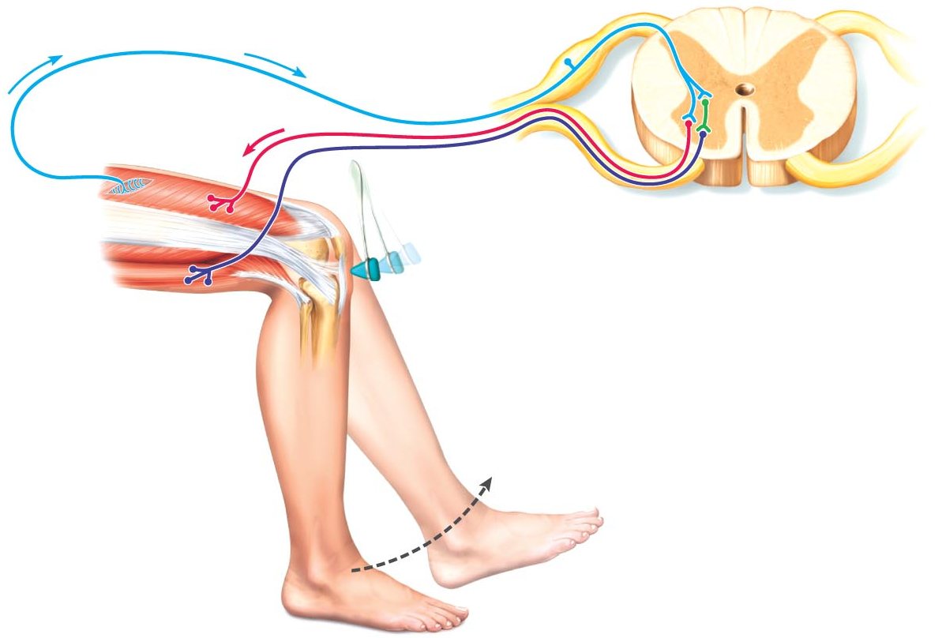
Figure 13.18 Stretch Reflex (2 of 2)
Slide 6
The patellar (knee-jerk) reflex—an example of a stretch reflex
2
Quadriceps
(extensors)
3a
+
3b
+
3b
–
1
Patella
Muscle
spindle
Spinal cord
(L₂–L₄)
1
Tapping the patellar ligament stretches the quadriceps and excites its muscle spindles.
Hamstrings
(flexors)
Patellar ligament
Afferent impulses (blue) travel to the spinal cord, where synapses occur with motor neurons and interneurons.
2
3a
The motor neurons (red) send activating impulses to the quadriceps causing it to contract, extending the knee.
The interneurons (green) make inhibitory synapses with ventral horn neurons (purple) that prevent the antagonist muscles (hamstrings) from resisting the contraction of the quadriceps.
3b
+ Excitatory synapse
– Inhibitory synapse

Slide 49
Figure 13.18 Stretch Reflex (2 of 2)
Slide 7
The patellar (knee-jerk) reflex—an example of a stretch reflex
Quadriceps
(extensors)
+
+
–
1
Patella
Muscle
spindle
Spinal cord
(L₂–L₄)
1
Tapping the patellar ligament stretches the quadriceps and excites its muscle spindles.
Hamstrings
(flexors)
Patellar ligament
+ Excitatory synapse
– Inhibitory synapse

Slide 50
Figure 13.18 Stretch Reflex (2 of 2)
Slide 8
The patellar (knee-jerk) reflex—an example of a stretch reflex
2
Quadriceps
(extensors)
+
+
–
1
Patella
Muscle
spindle
Spinal cord
(L₂–L₄)
1
Tapping the patellar ligament stretches the quadriceps and excites its muscle spindles.
Hamstrings
(flexors)
Patellar ligament
Afferent impulses (blue) travel to the spinal cord, where synapses occur with motor neurons and interneurons.
2
+ Excitatory synapse
– Inhibitory synapse

Slide 51
Figure 13.18 Stretch Reflex (2 of 2)
Slide 9
The patellar (knee-jerk) reflex—an example of a stretch reflex
2
Quadriceps
(extensors)
3a
+
+
–
1
Patella
Muscle
spindle
Spinal cord
(L₂–L₄)
1
Tapping the patellar ligament stretches the quadriceps and excites its muscle spindles.
Hamstrings
(flexors)
Patellar ligament
Afferent impulses (blue) travel to the spinal cord, where synapses occur with motor neurons and interneurons.
2
3a
The motor neurons (red) send activating impulses to the quadriceps causing it to contract, extending the knee.
+ Excitatory synapse
– Inhibitory synapse

Slide 52
Figure 13.18 Stretch Reflex (2 of 2)
Slide 10
The patellar (knee-jerk) reflex—an example of a stretch reflex
2
Quadriceps
(extensors)
3a
+
3b
+
3b
–
1
Patella
Muscle
spindle
Spinal cord
(L₂–L₄)
1
Tapping the patellar ligament stretches the quadriceps and excites its muscle spindles.
Hamstrings
(flexors)
Patellar ligament
Afferent impulses (blue) travel to the spinal cord, where synapses occur with motor neurons and interneurons.
2
3a
The motor neurons (red) send activating impulses to the quadriceps causing it to contract, extending the knee.
The interneurons (green) make inhibitory synapses with ventral horn neurons (purple) that prevent the antagonist muscles (hamstrings) from resisting the contraction of the quadriceps.
3b
+ Excitatory synapse
– Inhibitory synapse

Slide 53
The Tendon Reflex
Polysynaptic reflexes
Helps prevent damage due to excessive stretch
Important for smooth onset and termination of muscle contraction

Slide 54
The Tendon Reflex
Produces muscle relaxation (lengthening) in response to tension
  Contraction or passive stretch activates tendon reflex
  Afferent impulses transmitted to spinal cord
    Contracting muscle relaxes; antagonist contracts (reciprocal activation)
  Information transmitted simultaneously to cerebellum and used to adjust muscle tension

Slide 55
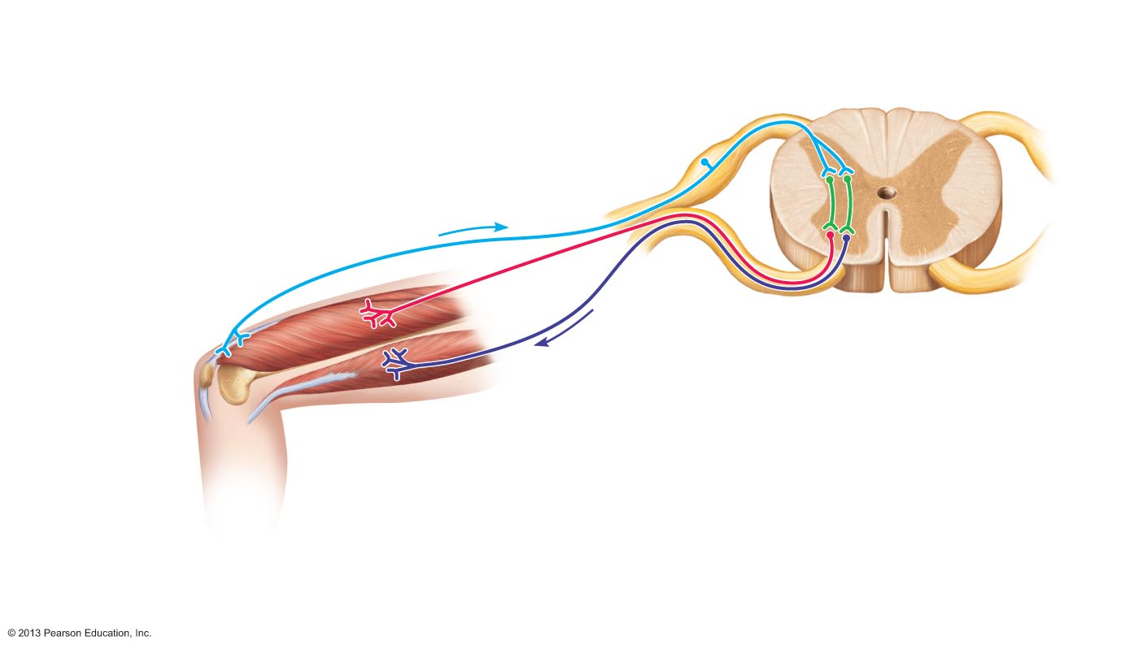
Figure 13.19 The tendon reflex.
Slide 1
Afferent fibers synapse with
interneurons in the spinal cord.
1
2
Quadriceps strongly contracts.
Tendon organs are activated.
Interneurons
+
+
Quadriceps
(extensors)
–
+
Tendon organ
Spinal cord
Hamstrings
(flexors)
Efferent impulses
to antagonist muscle
cause it to contract.
Efferent
impulses to muscle
with stretched
tendon are damped.
Muscle relaxes,
reducing tension.
3b
3a
+ Excitatory synapse
– Inhibitory synapse

Slide 56
Figure 13.19 The tendon reflex.
Slide 2
1
Quadriceps strongly contracts.
Tendon organs are activated.
Interneurons
+
+
Quadriceps
(extensors)
–
+
Tendon organ
Spinal cord
Hamstrings
(flexors)
+ Excitatory synapse
– Inhibitory synapse

Slide 57
Figure 13.19 The tendon reflex.
Slide 3
Afferent fibers synapse with
interneurons in the spinal cord.
1
2
Quadriceps strongly contracts.
Tendon organs are activated.
Interneurons
+
+
Quadriceps
(extensors)
–
+
Tendon organ
Spinal cord
Hamstrings
(flexors)
+ Excitatory synapse
– Inhibitory synapse

Slide 58
Figure 13.19 The tendon reflex.
Slide 4
Afferent fibers synapse with
interneurons in the spinal cord.
1
2
Quadriceps strongly contracts.
Tendon organs are activated.
Interneurons
+
+
Quadriceps
(extensors)
–
+
Tendon organ
Spinal cord
Hamstrings
(flexors)
Efferent
impulses to muscle
with stretched
tendon are damped.
Muscle relaxes,
reducing tension.
3a
+ Excitatory synapse
– Inhibitory synapse

Slide 59
Figure 13.19 The tendon reflex.
Slide 5
Afferent fibers synapse with
interneurons in the spinal cord.
1
2
Quadriceps strongly contracts.
Tendon organs are activated.
Interneurons
+
+
Quadriceps
(extensors)
–
+
Tendon organ
Spinal cord
Hamstrings
(flexors)
Efferent impulses
to antagonist muscle
cause it to contract.
Efferent
impulses to muscle
with stretched
tendon are damped.
Muscle relaxes,
reducing tension.
3b
3a
+ Excitatory synapse
– Inhibitory synapse

Slide 60
The Flexor and Crossed-Extensor Reflexes
Flexor (withdrawal) reflex
  Initiated by painful stimulus
  Causes automatic withdrawal of threatened body part
  Ipsilateral and polysynaptic
  Protective; important
  Brain can override
    E.g., finger stick for blood test

Slide 61
Flexor and Crossed-Extensor Reflexes
Crossed extensor reflex
  Occurs with flexor reflexes in weight-bearing limbs to maintain balance
  Consists of ipsilateral withdrawal reflex and contralateral extensor reflex
    Stimulated side withdrawn (flexed)
    Contralateral side extended
    e.g., step barefoot on broken glass

Slide 62
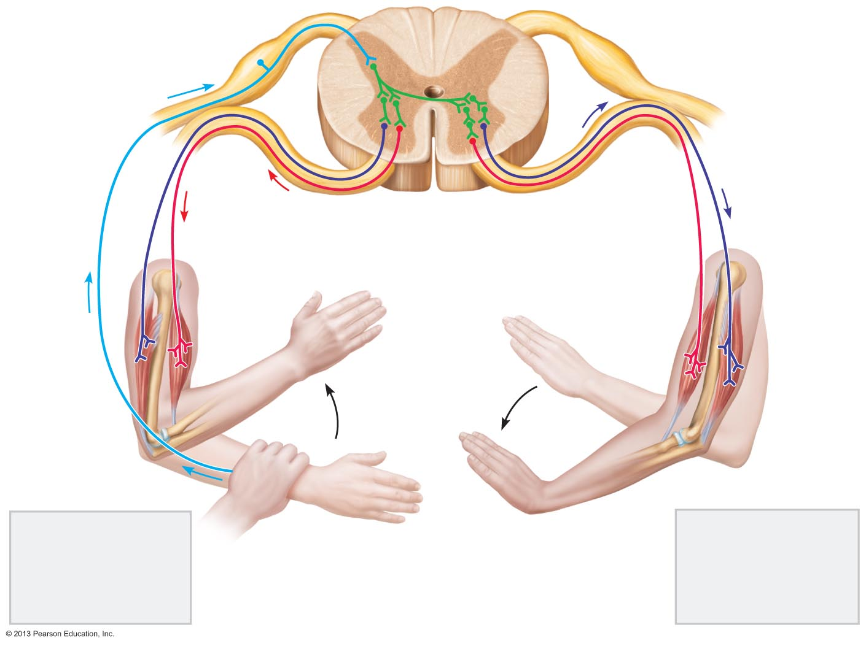
Figure 13.20 The crossed-extensor reflex.
+ Excitatory synapse
Interneurons
– Inhibitory synapse
+
+
–
+
+
–
Afferent
fiber
Efferent
fibers
Efferent
fibers
Extensor
inhibited
Flexor
inhibited
Flexor
stimulated
Flexes
Arm movements
Extensor
stimulated
Extends
Site of stimulus:
A noxious stimulus
causes a flexor
reflex on the same
side, withdrawing
that limb.
Site of reciprocal
activation: At the
same time, the
extensor muscles
on the opposite
side are activated.

Slide 63
Superficial Reflexes
Elicited by gentle cutaneous stimulation
Depend on upper motor pathways and cord-level reflex arcs
Best known:
  Plantar reflex
  Abdominal reflex

Slide 64
Superficial Reflexes: Plantar Reflex
Test integrity of cord from L₄ – S₂
Stimulus - stroke lateral aspect of sole of foot
Response - downward flexion of toes
Damage to motor cortex or corticospinal tracts → abnormal response = Babinski's sign
  Hallux dorsiflexes; other digits fan laterally
  Normal in infant to ~1 year due to incomplete myelination

Slide 65
Superficial Reflexes: Abdominal Reflexes
Test integrity of cord from T₈ – T₁₂
Cause contraction of abdominal muscles and movement of umbilicus in response to stroking of skin
Vary in intensity from one person to another
Absent when corticospinal tract lesions present

Slide 66
Developmental Aspects of the PNS
Spinal nerves branch from developing spinal cord and neural crest cells
Exit between forming vertebrae
  Supply both motor and sensory fibers to developing muscles to help direct their maturation
  Cranial nerves innervate muscles of head

Slide 67
Developmental Aspects of the PNS
Distribution and growth of spinal nerves correlate with segmented body plan
With age, sensory receptors atrophy, muscle tone decreases in face and neck, reflexes slow
  Decreased numbers of synapses per neuron, and slower central processing
Peripheral nerves viable throughout life unless subjected to trauma

